Slide 1
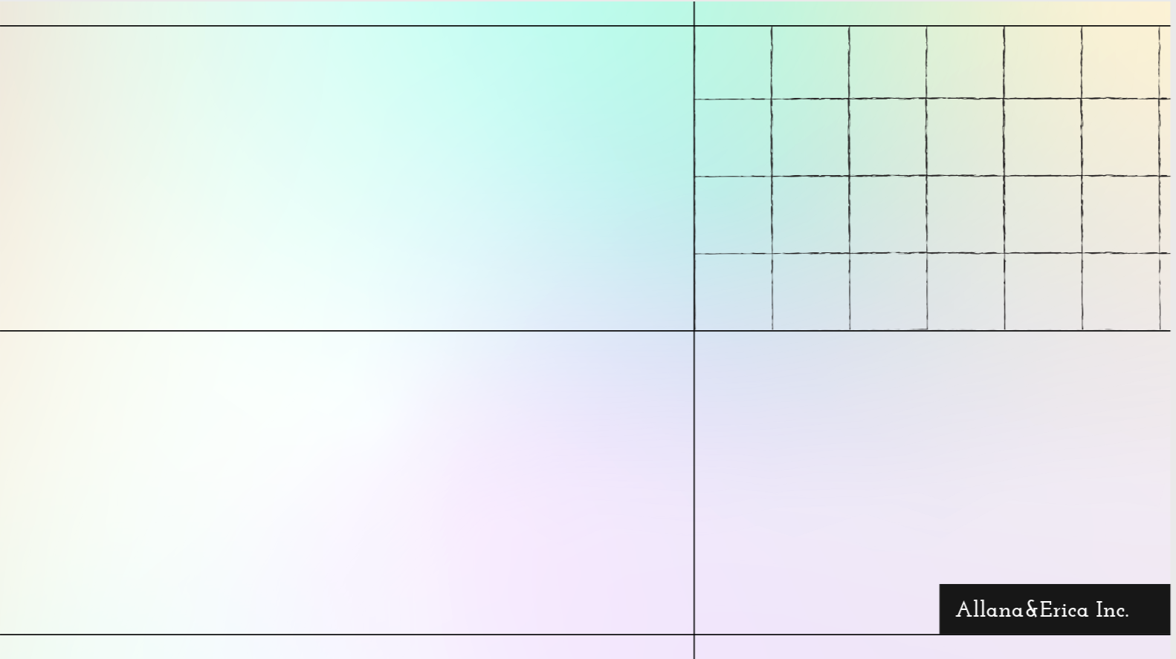

Predicting
Purchase Behavior
Take your marketing to the next level, keep your customers coming back, and help your business grow.
By: Erica Yanoshak and Allana Nelson

Slide 2

Importance of Predicting Customer Purchase Behavior
Deep Understanding of Customer Behavior: Predicting customer behavior helps businesses understand preferences, habits, and decision-making processes.
Personalized Marketing and Experiences: Predictive analytics enables businesses to create tailored marketing strategies, delivering personalized customer experiences.
Improved Customer Acquisition and Retention: By anticipating customer needs, businesses can engage, retain, and build loyalty among their customers more effectively.
Competitive Advantage: Predicting buying behavior helps identify emerging trends and market opportunities, giving businesses an edge over competitors.
Enhanced Growth and Customer Satisfaction: Accurate predictions allow businesses to refine strategies, optimize the customer journey, and drive growth through improved customer satisfaction.

Slide 3
Customer Purchase Prediction Model Plus Feature Importance
Problem to Solve: Develop a predictive model to determine the likelihood of a customer making a purchase based on historical behavior and other demographic data.
Model Selection: supervised learning approach, logistic regression, decision trees, or random forest, to predict whether a customer will make a purchase.
Evaluation: Using metrics like accuracy, precision, recall, F1-score, and ROC-AUC to evaluate model performance.
Optimization: Through random search, SMOTE, and stacking models
Analyze the features to learn what does and does not lead, to customers making a purchase
Evaluation: Using feature importance, identify how each variable impacts potential purchase behavior
Technologies: Scikit-learn for the model, Pandas and Matplotlib for data handling and visualization, and Python for scripting.

Slide 4

Features
Age | Customer's age | 20 - 70 yrs old
Gender | Customer's gender | 0: Male 1: Female
Annual Income | Customer's annual income in dollars | 20k - 140k
Number of Purchases | Total purchases made | 0 - 20
Product Category | Category of the purchased product | 0: Electronics 1: Clothing 2: Home Goods 3: Beauty 4: Sports
Time Spent on Website | Time spent in minutes | 0 - 59
Loyalty Program | Loyalty program participation | 0: No 1: Yes
Discounts Availed | Number of discounts availed by the customer | 0, 1, 2, 3, 4, 5
Data Preprocess
Dataset contained recent information on customer purchase behavior across various attributes, aiming to help data scientists and analysts understand the factors influencing purchase decisions
After removing Product Category and Gender, and with the exception of Loyal, we were left with numerical formats with no null values or rows
Scaled numerical features to bring them to a similar range using StandardScaler.
Conducted Exploratory Data Analysis (EDA) to understand the relationships in data
Split Data into Training and Testing Sets
Target Variable
Purchase Status | Likelihood of the customer making a purchase | 0: No 1: Yes
Rabie El Kharoua. (2024). Predict Customer Purchase Behavior Dataset [Data set]. Kaggle. https://doi.org/10.34740/KAGGLE/DSV/8725150
Notes:
Familiered self with dataset, running various

Slide 5

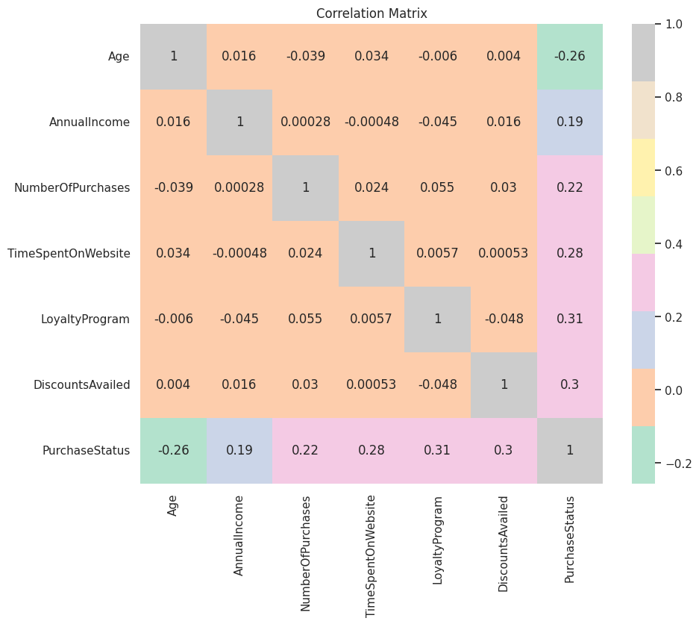
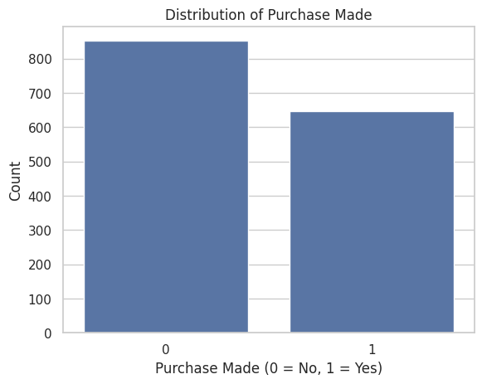
Exploratory Data Analysis (EDA)
Conducted EDA to understand the relationships in data
852
648
57%
43%

Slide 6
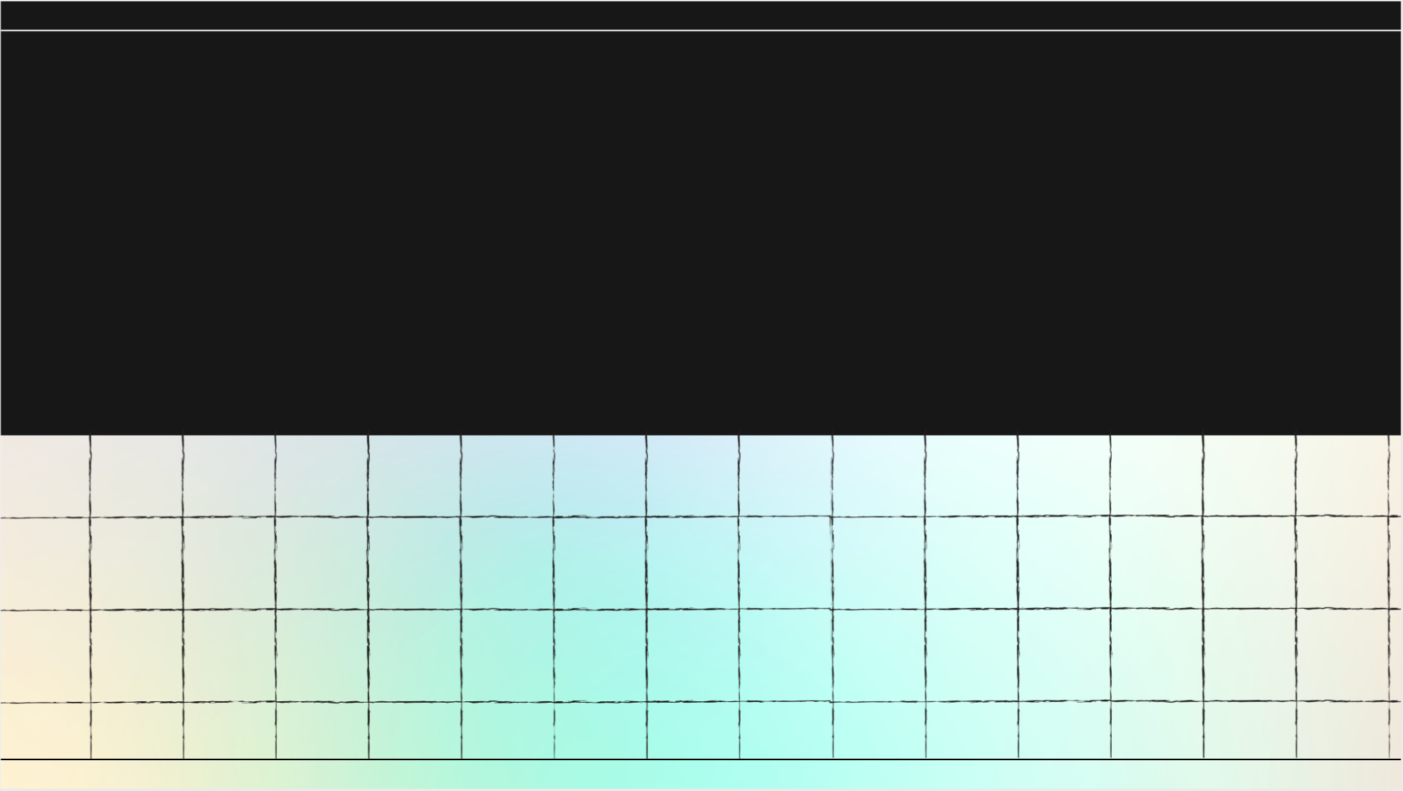
Implementation & Evaluation

Slide 7
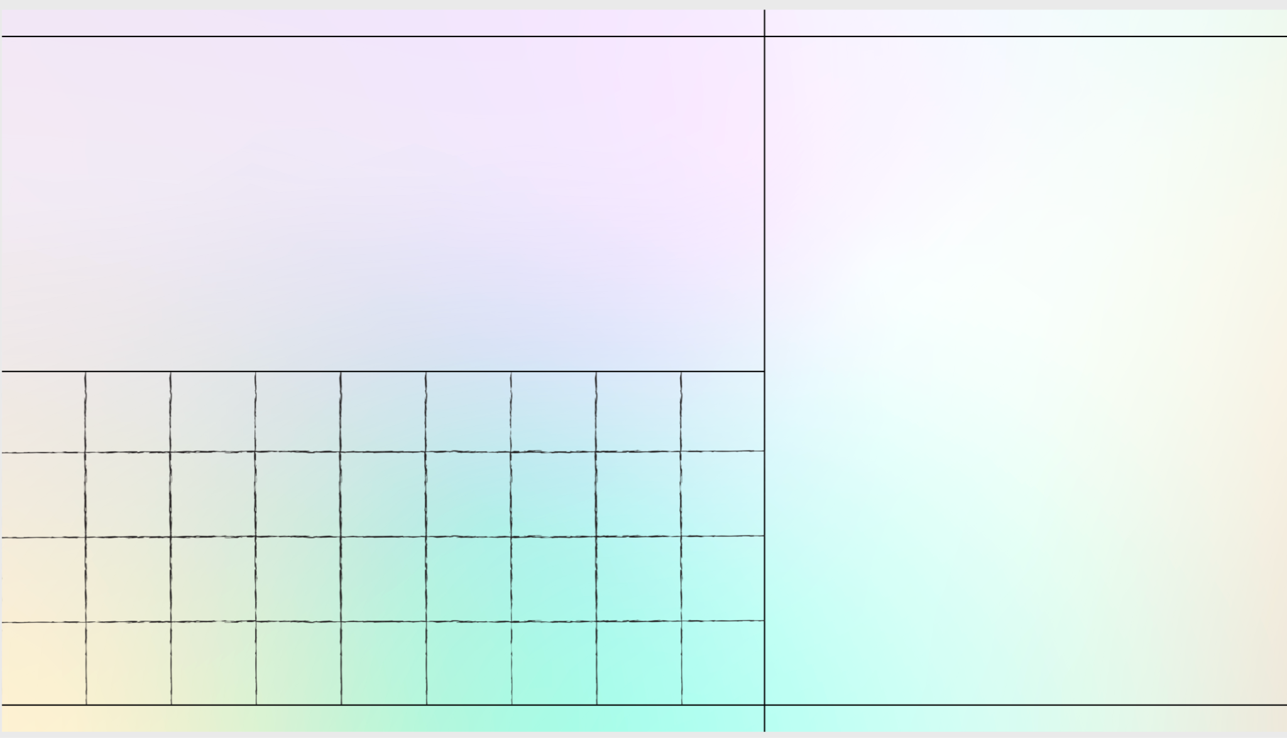
Model Implementation
Model Selection
Logistic Regression: Started with a simple model to establish a baseline performance
Decision Trees: Great for understanding decision-making processes
Random Forest: Often provides the best performance by averaging out the decisions of multiple trees

Slide 8
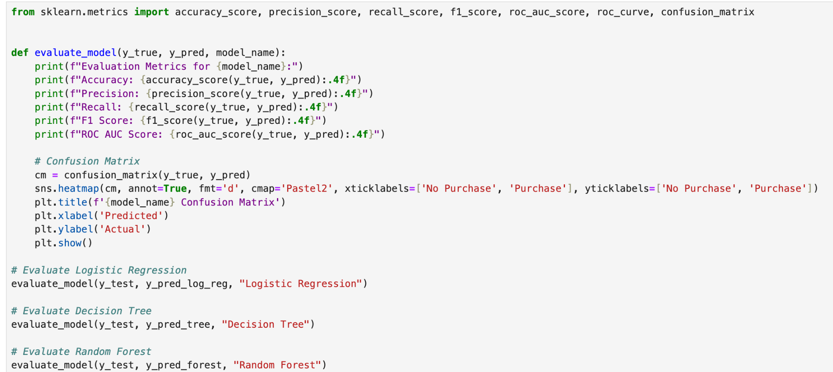
Model Evaluation
Evaluated the performance of the selected models using specific metrics
Defined a Function for Evaluation
To avoid repetitive code, we created a function that evaluates and prints these metrics for any model.
Accuracy
Precision
Recall
F1-score
ROC-AUC

Slide 9
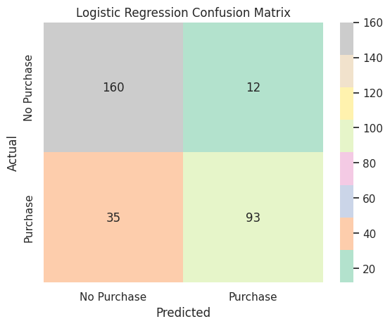
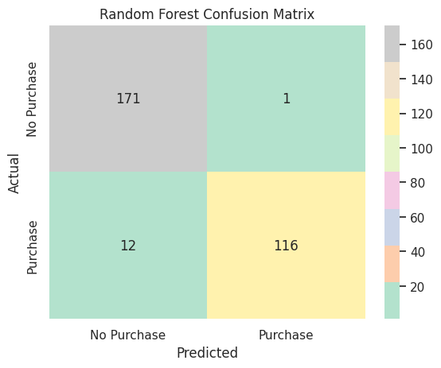
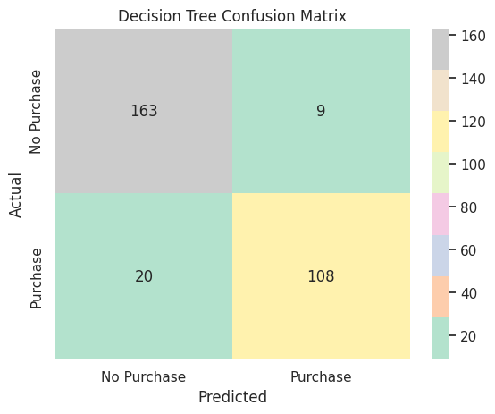
Evaluation Metrics Pre-Optimization
Evaluation Metrics for Decision Tree:
Accuracy: 0.9067
Precision: 0.9386
Recall: 0.8359
F1 Score: 0.8843
ROC AUC Score: 0.8976
Evaluation Metrics for Logistic Regression:
Accuracy: 0.8433
Precision: 0.8857
Recall: 0.7266
F1 Score: 0.7983
ROC AUC Score: 0.8284
Evaluation Metrics for Random Forest:
Accuracy: 0.9567
Precision: 0.9915
Recall: 0.9062
F1 Score: 0.9469
ROC AUC Score: 0.9502

Slide 10
Model Optimization & Evaluation

Slide 11

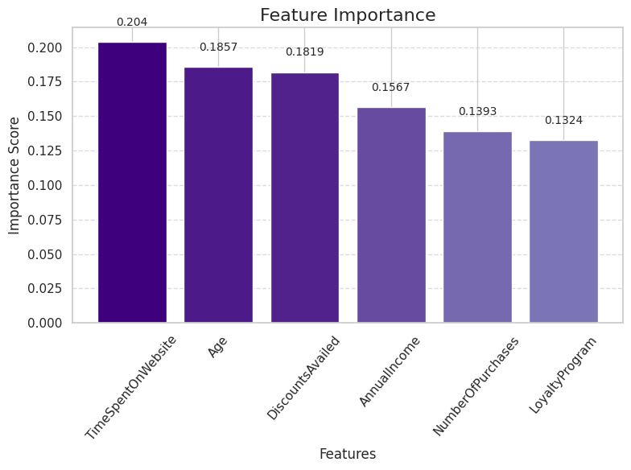
Model Optimization
Hyperparameter Tuning
Random Search
Evaluation Metrics for Random Search Model:
Training: 0.9725
Accuracy: 0.9500
Precision: 0.9748
Recall: 0.9062
F1 Score: 0.9393
ROC AUC Score: 0.9444
Notes:
Random Search
Purpose: Random search is a hyperparameter optimization technique. It randomly samples combinations of hyperparameters within a predefined search space to find the best performing set of hyperparameters for a model.
When Used: Random search is used after a model architecture is defined but before training it. It optimizes parameters like learning rate, number of layers, regularization factors, etc.
Hyperparameter Tuning Grid Search and Random Search are two popular methods to systematically explore a range of hyperparameters for your Random Forest model.
1.2. Random Search
Random Search is a more efficient approach that samples random combinations of hyperparameters and is particularly useful when the parameter grid is large.

Slide 12
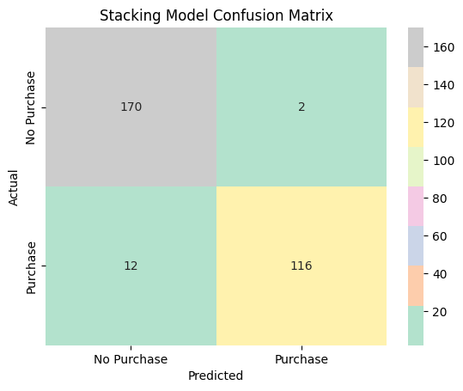
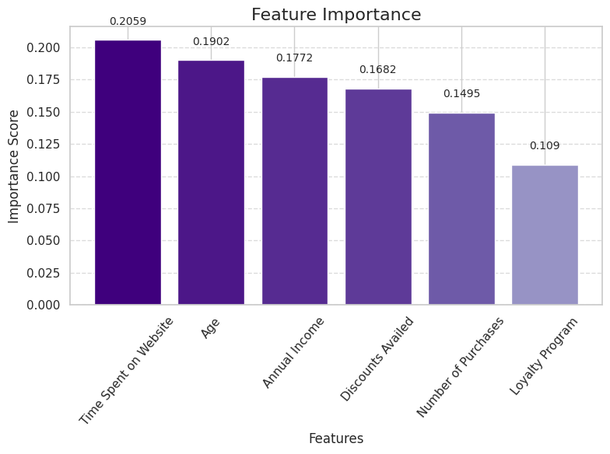
Model Optimization
Ensemble Methods
Stacking
Evaluation Metrics for Stacking Model:
Training: 0.9967
Accuracy: 0.9533
Precision: 0.9831
Recall: 0.9062
F1 Score: 0.9431
ROC AUC Score: 0.9473
Notes:
Ensemble Methods to reduce bias
Combine the Random Forest model with other models to create a more robust ensemble. Stacking is a method where you combine the predictions of multiple models (e.g., Random Forest, Logistic Regression, Gradient Boosting) using another model as a "meta-learner."

Slide 13

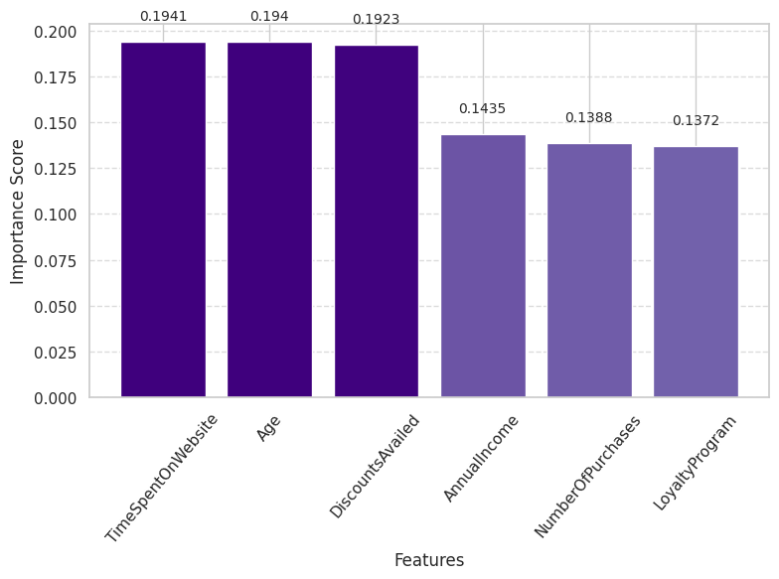
Model Optimization
Class Imbalance
Handling SMOTE
Evaluation Metrics for SMOTE Model:
Training: 0.9742
Accuracy: 0.9567
Precision: 0.9752
Recall: 0.9219
F1 Score: 0.9478
ROC AUC Score: 0.9522
Notes:
Class Imbalance Handling
If your dataset has a class imbalance (e.g., far more "no purchase" cases than "purchase" cases), consider techniques like SMOTE (Synthetic Minority Over-sampling Technique) to create a balanced training set.

Slide 14
Results / Conclusions

Slide 15
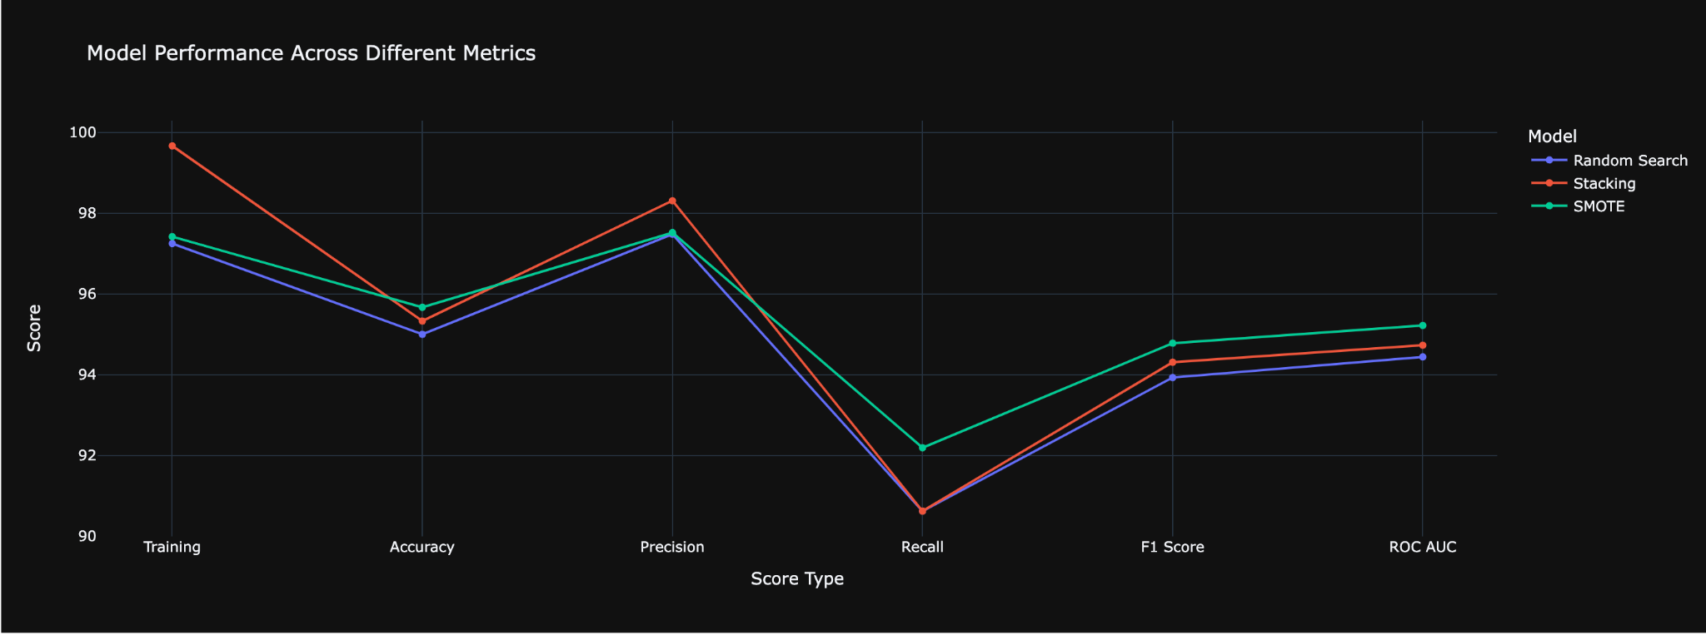
Model Optimization Results
Random Forest Model Optimization Scores
Score Type | Random Search | Stacking | SMOTE
Training | 97.25% | 99.67% | 97.42%
Accuracy | 95.00% | 95.33% | 95.67%
Precision | 97.48% | 98.31% | 97.52%
Recall | 90.62% | 90.62% | 92.19%
F1 Score | 93.93% | 94.31% | 94.78%
ROC AUC | 94.44% | 94.73% | 95.22%

Slide 16
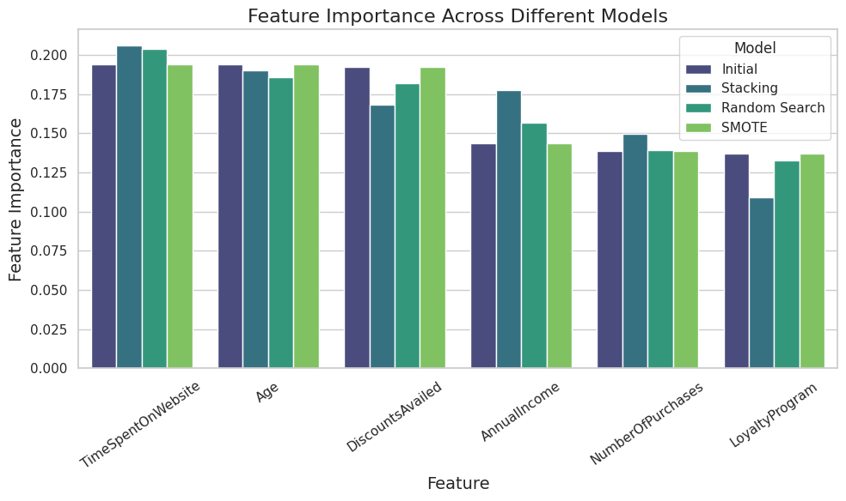
Feature Importance
Optimized Models Feature Important Values
Model | Time Spent on Website | Age | Discounts | Annual Income | # of Purchases | Loyalty Program
Initial | 0.194094 | 0.193980 | 0.192347 | 0.143550 | 0.138833 | 0.137196
Stacking | 0.205891 | 0.190175 | 0.168159 | 0.177235 | 0.149491 | 0.10905
Random Search | 0.203998 | 0.185685 | 0.181936 | 0.156703 | 0.139254 | 0.132424
SMOTE | 0.194094 | 0.193980 | 0.192347 | 0.143550 | 0.138833 | 0.137196

Slide 17

Next steps
1. Experiment with More Complex Models:
Gradient Boosting (e.g., XGBoost, LightGBM):
Marketing teams can experiment with these models to capture more intricate patterns in behavior
Next Step: Run experiments with these models and compare them against existing models using the same evaluation metrics (accuracy, precision, recall, F1-score, ROC AUC).
2. Explore Time-Series Models:
Time-Series Models (e.g., ARIMA, LSTM):
For customers with recurring purchase patterns, time-series models can predict future purchases based on historical trends.
Next Step: Implement models that account for temporal data, such as using past purchasing behaviors to predict future buying tendencies. Long Short-Term Memory (LSTM) networks are ideal for capturing sequential data patterns.
3. Use K-Nearest Neighbors (KNN) for Behavioral Similarity:
KNN for Customer Segmentation:
KNN can identify customers with similar behaviors and segment them for targeted marketing campaigns.
Next Step: Cluster customers with KNN to identify similar profiles and adjust marketing strategies to target specific segments with similar purchase behaviors.

Slide 18
Questions?
Thank You!

